Slide 1

Analyzation of Financial Data on Predicting Net Income of a Building Services Company from 2019-2023
Shelley Wright

Slide 2
INTRODUCTION
This project aims to analyze the financial data of a building services company where I have been employed for 25 years.
The primary research question is: What predictor variables influence net income?
Identifying these key factors will provide insights into financial trends and potential areas for optimization.

Slide 3
Data Cleaning Process
Data was exported from Quickbooks. Each year created a separate dataset.
Columns were created for year in each dataset.
The datasets was transposed and merged into a single, structured dataset for analysis.
In compliance with the business owner’s confidentiality request, account names and the company name will be anonymized.
Accounts were categorized into four main sectors: Commercial, Industrial, University, and Medical.

Slide 4
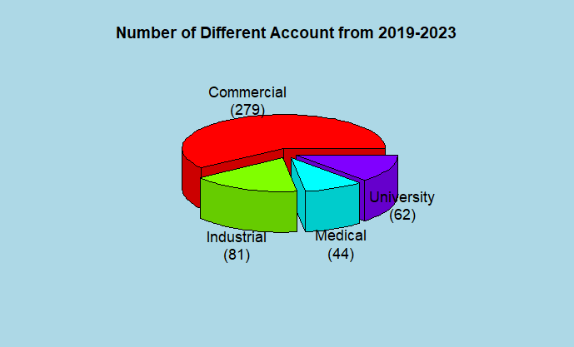
Dataset Demographics
Plot created by package plotrix in R.
Pie3D function was used

Slide 5
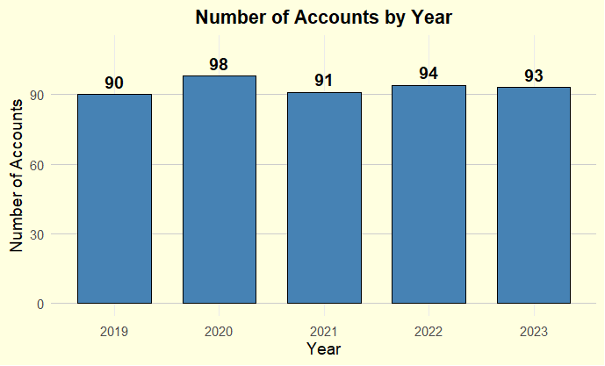
Graph created by ggplot

Slide 6
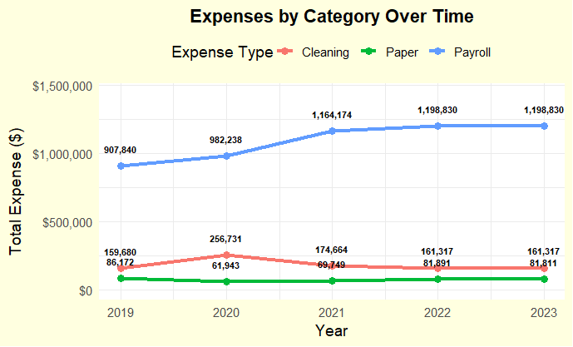
Created by ggplot

Slide 7
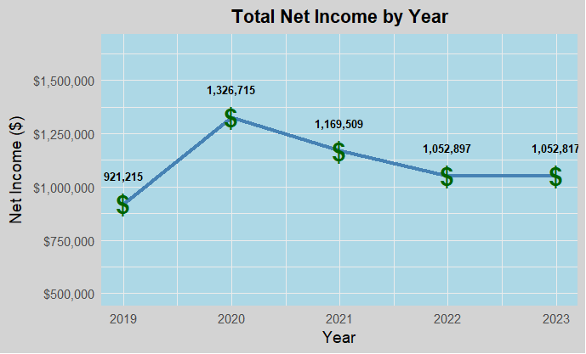
Created by ggplot $ added by geom_text

Slide 8
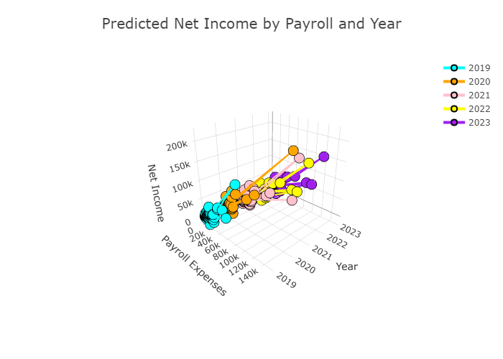
Package plot_ly - allowed the plot to be turned for the correct angle

Slide 9
Analysis: Full Regression Model
Model = Net Income ~ Class + Year + Cleaning Supplies + Paper goods +Payroll expenses
Residual standard error: 9498 on 457 degrees of freedom Multiple R-squared: 0.8172, Adjusted R-squared: 0.814 F-statistic: 255.4 on 8 and 457 DF, p-value: < 2.2e-16

Slide 10
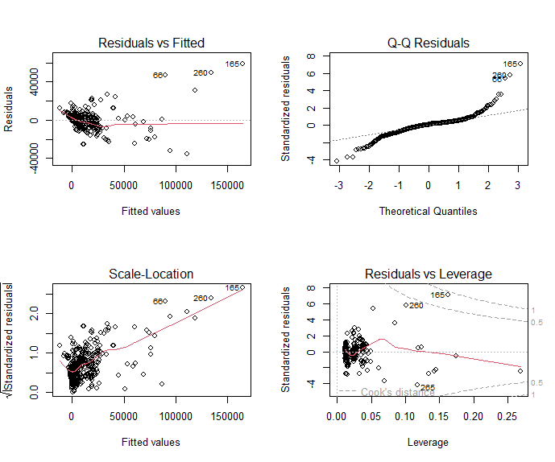
Residual Test
Residual vs Fitted- Most are centered around 0
Q-Q Residuals – heavy deviation in tails- could be problematic
Scale- Location – Upward trend suggests heteroscedasticity- variance increases with the fitted values-
Residual vs Leverage– Few high points maybe need to investigate

Slide 11
Full and Log Transformation Model Comparisons
Metric | Model 1<br>(Net Income) | Model 2<br>(log(Net Income)) | Interpretation Note
Residual Std. Error | 9,498 | 1.225 | Model 2 has much lower error on the log scale; better handles skewed residuals
R-squared | 0.8172 | 0.4356 | Model 1 explains more variance in raw Net Income
Adjusted R-squared | 0.814 | 0.4292 | Model 1 has stronger overall explanatory power
F-statistic | 255.4 (df = 8, 457) | 68.68 (df = 5, 445) | Both models are statistically significant (p < 0.001)
Overall p-value | < 2.2e-16 | < 2.2e-16 | Model significance is strong in both
Observations Used | 466 | 461 | Slight difference due to NA removal
Use Case Recommendation | Use when residuals are well-behaved & raw output is needed | Use when data is skewed or residuals show non-constant variance | Model 2 better meets assumptions; Model 1 better fits raw scale

Slide 12
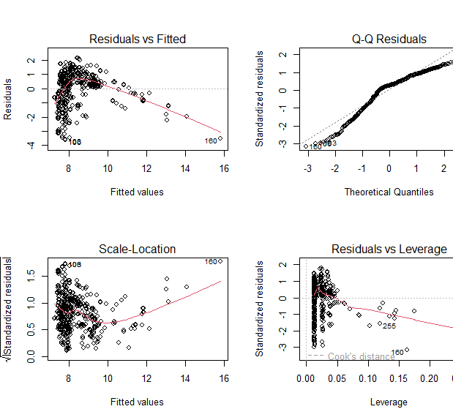
1. Residuals vs Fitted Trend still curved → Indicates non-linearity or misspecification Some clustering and outliers at higher fitted values transformation helped some, but not fully. 2. Q-Q Plot S-shaped curve → residuals still not fully normal. Improvement over before, but deviation in both tails . 3. Scale-Location Plot Shows increasing spread at higher fitted values. Heteroscedasticity (non-constant variance) is reduced but not gone. 4. Residuals vs Leverage Still a few influential points (like obs. 160 and 255). Cook’s Distance line suggests some points could strongly affect your estimates.
Further Analysis Decided to use log transform on the predictor variable (Net Income) to address the major issues with the full model

Slide 13
Why Robust Regression
Why Use Robust Regression?
Outliers exist in the dataset that distort the ordinary least squares.
Residuals show non-normality or heavy tails.
There is heteroscedasticity (non-constant error variance)- means The variance of residuals increases or decreases depending on the value of one or more predictors.
Trying to obtain a model that still performs well under mild violations of standard linear model assumptions.

Slide 14
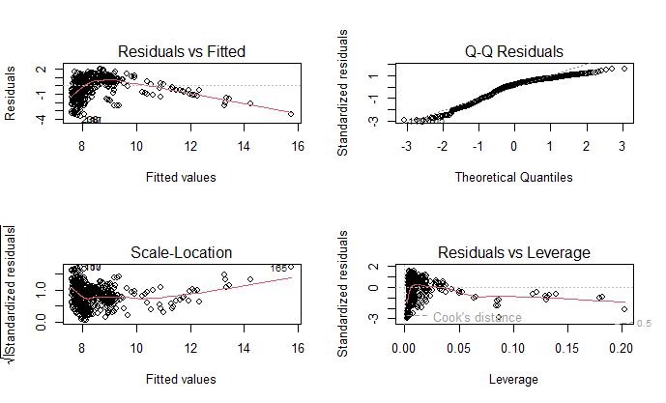
outliers |  | ✅ Much better
Residual spread |  | Still uneven but reduced
Linearity |  | Still questionable
Normality |  | Slightly improved
Influence |  | ✅ Reduced influence
ROBUST MODEL OUTLIER RESULTS

Slide 15
--- Model Comparison -- Log transformation AND Robust Model
Term | lm() Estimate | rlm() Estimate | Interpretation
(Intercept) | 7.856 | 7.970 | Slightly higher baseline in robust model
Year2022 | -0.393 (p = .03) | -0.331 (marginal) | Both suggest ↓ Net Income in 2022
Year2023 | -0.372 (p = .04) | -0.318 (marginal) | Robust model softens the drop
Class_LabelUniversity | 0.560 (p = .001) | 0.514 (strong) | Stronger positive effect remains
Payroll.Expenses | 4.13e-5 (p < .001) | stable and strong | Major positive association
Paper.Goods | 8.71e-5 (p < .001) | similar & strong | Still highly significant
Cleaning.Supplies | 6.88e-5 (p = .0015) | similar & strong | Still highly significant

Slide 16
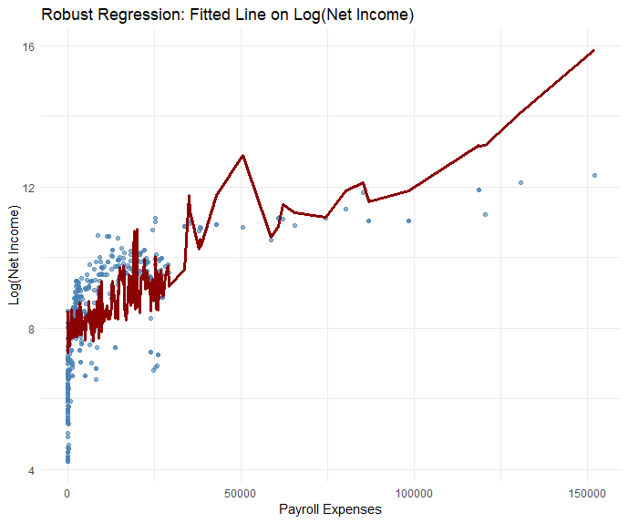
Robust Fitted Line
Blue dots – observed data points
Red Line- fitted values from Robust
Non-linear relationship and is less
sensitive to outliers
Robust Fit isn’t distorted by outliers

Slide 17
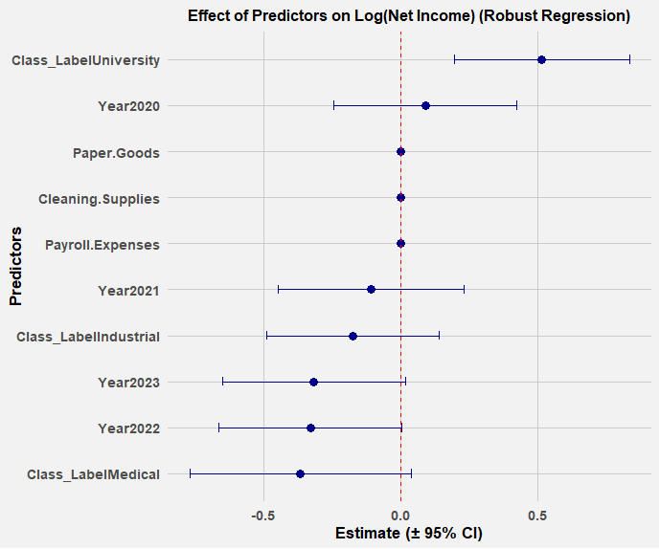
Effect of Predictor Factors on log Net Income

Slide 18
Results of Analysis:
More investigation needs to occur to get a better fitted model
Maybe use splices and GAM in Robust Regression
Models did improve but not to my satisfaction

Slide 19

Questions ?

